Slide 1
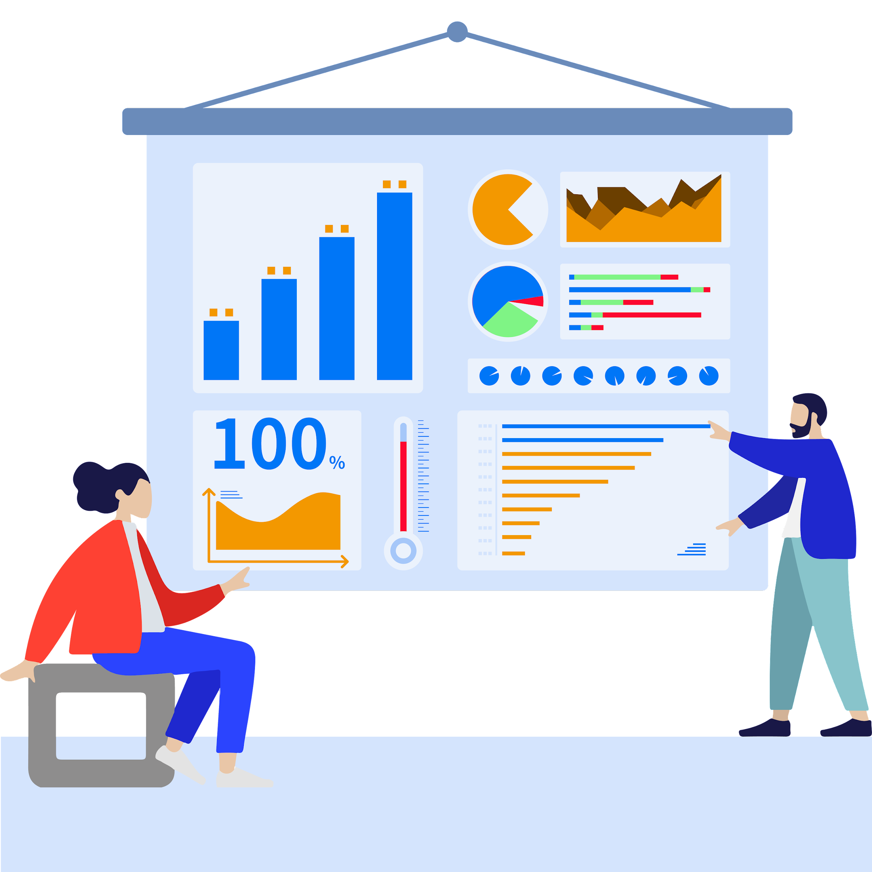
ZSH
Information
Visualization Journey
Statistics
Visualization Semester-End Wrapped
Explore the experience of information visualization and reveal the story of the data. Information Visualization Semester-End Wrapped is a review of my learning journey, summarizing the insights and skills gained in this field. Through graphs and charts, I will demonstrate my understanding of data and explore how to convey information visually.
Presented by: ZHAO Shanhe
Information Visualization Semester-End Wrapped
Notes:
Hello everyone, I'm Edward ZHAO. I wonder if there's any concept of day and night where you are. But here, I wish you all a good morning, noon and evening!
This show will showcase how I explore the experience of information visualization and reveal the story of the data. Information Visualization Semester-End Wrapped is a review of my learning journey, summarizing the insights and skills gained in this field. Through graphs and charts, I will demonstrate my understanding of data and explore how to convey information visually.

Slide 2
Contents
01
02
03
04
Tracklist Design
Chart-Topper Analysis
Reflection
Future Hits
My information visual tracklist details. These include: the topics I worked on, the topic covers, the time spent on each topic, etc.
My information visualization chart topper analysis. These include: the topics I worked on the most, my most successful teamwork, the peak of the learning curve, etc.
My study reflection. These include: What I learned, how I overcame difficulties, what my album will be about, etc.
Summary of my work and outlook for the future.
Notes:
In my Information Visualization Semester-End Wrapped, there are the following sections:
First, Tracklist Design. This is my information visual tracklist details. These include: the topics I worked on, the topic covers, the time spent on each topic, etc.
Second, Chart-Topper Analysis. This is my information visualization chart topper analysis. These include: the topics I worked on the most, my most successful teamwork, the peak of the learning curve, etc.
Third, Reflection. This is my study reflection. These include: What I learned, how I overcame difficulties, what my album will be about, etc.
Fourth, Future Hits. It's about a summary of my work and outlook for the future.

Slide 3

ZSH
Part 01
Tracklist Design
My information visual tracklist details. These include: the topics I worked on, the topic covers, the time spent on each topic, etc.
Notes:
This is the first part. Tracklist Design.

Slide 4
Topic
01
Tracklist Design
Titanic
Topic
Shop Business Research
Topic
Tracklist Design
Topic
APP Statistics
Smoking Statistics for the UK
The topics I worked on
Topic
The information visualization topics I worked on are roughly divided into nine sections: Titanic survivor data visualization, shop business research information visualization, Google APP Store statistics visualization, smoking statistics for the UK information visualization, commercial flight data information visualization, global air pollution information visualization, data science staff salary information visualization, hotel market analysis information visualization and others (general content is viewing other people's works, self-study courseware content, etc.)
Topic
Commercial Flight
Global Air Pollution
Topic
Topic
Data Science Staff Salary
Hotel Market Analysis
Topic
Others
Notes:
The information visualization topics I worked on are roughly divided into nine sections: Titanic survivor data visualization, shop business research information visualization, Google APP Store statistics visualization, smoking statistics for the UK information visualization, commercial flight data information visualization, global air pollution information visualization, data science staff salary information visualization, hotel market analysis information visualization and others. The general content of Others is viewing other people's works, self-study courseware content, etc.

Slide 5
01
Tracklist Design
Tracklist Design
The topic covers
The topic covers the humanities, business, health and environment, and others. Among them, information visualization for business is the type I sat on most this semester.
Notes:
The topic covers the humanities, business, health and environment, and others. Among them, information visualization for business is the type I sat on most this semester.

Slide 6
01
Tracklist Design
Tracklist Design
The time spent on each topic
Among the topics I am committed to, besides courseware research and self-study of information visualization (these are classified into Others), the topic I spend the most time on is Hotel Market Analysis. Because it's my group project. As for the other topics, the tasks in the course, I don't spend too much time on each topic. Because I've learned a lot about information visualization in my previous job.
Notes:
Among the topics I am committed to, besides courseware research and self-study of information visualization, whick are classified into Others, the topic I spend the most time on is Hotel Market Analysis. Because it's my group project. As for the other topics, the tasks in the course, I don't spend too much time on each topic. Because I've learned a lot about information visualization in my previous job.

Slide 7
ZSH
Part 02
Chart-Topper Analysis
My information visualization chart topper analysis. These include: the topics I worked on the most, my most successful teamwork, the peak of the learning curve, etc.
Notes:
This is the second part. Chart-Topper Analysis.

Slide 8
01
Tracklist Design
Chart-Topper Analysis
The topics I worked on the most
In the previous presentation, I have already drawn my topic radar chart. It's clear that I spend the most on business-related information visualization, both in terms of work time and project data.
Notes:
In the previous presentation, I have already drawn my topic radar chart. It's clear that I spend the most on business-related information visualization, both in terms of work time and project data.

Slide 9

01
Tracklist Design
Chart-Topper Analysis
My most successful teamwork
My most successful teamwork is my group project: Hotel Booking Demand -- Hotel Market Analysis. We do this by visualizing the hotel's data and then analyzing it. And solved a lot of problems. For example, what is the relationship between hotel room reservation and time, and what business adjustments should be made by the hotel for different periods of the market, and so on.
Notes:
My most successful teamwork is my group project: Hotel Booking Demand -- Hotel Market Analysis. We do this by visualizing the hotel's data and then analyzing it. And solved a lot of problems. For example, what is the relationship between hotel room reservation and time, and what business adjustments should be made by the hotel for different periods of the market, and so on.

Slide 10
01
Tracklist Design
Chart-Topper Analysis
The peak of the learning curve
The peak of my learning curve comes in March. This month, I will complete tasks, prepare for group projects, review old knowledge, and preview new knowledge. So in this month, my study life is very busy and full.
Notes:
The peak of my learning curve comes in March. This month, I will complete tasks, prepare for group projects, review old knowledge, and preview new knowledge. So in this month, my study life is very busy and full.

Slide 11
ZSH
Part 03
Reflection
My study reflection. These include: What I learned, how I overcame difficulties, what my album will be about, etc.
Notes:
This is the third part. Reflection.

Slide 12

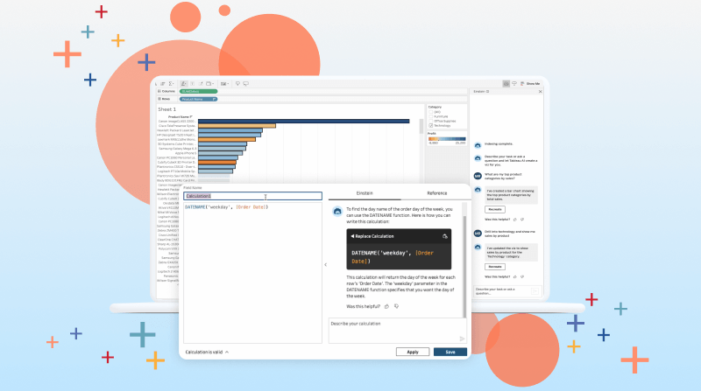

01
Tracklist Design
Reflection
What I learned
In the information visualization course, I learned how to effectively transform data into visual graphics to convey information and insights more clearly. I mastered various visualization tools and techniques such as Tableau, D3.js, and Python, and learned how to choose appropriate chart types and color schemes to present data. Additionally, I learned how to design intuitive and understandable data charts, and gained an understanding of the importance of data visualization in decision-making and communication.
Notes:
In the information visualization course, I learned how to effectively transform data into visual graphics to convey information and insights more clearly. I mastered various visualization tools and techniques such as Tableau, D3.js, and Python, and learned how to choose appropriate chart types and color schemes to present data. Additionally, I learned how to design intuitive and understandable data charts, and gained an understanding of the importance of data visualization in decision-making and communication.

Slide 13

01
Tracklist Design
Reflection
How I overcame difficulties
In the information visualization course, I encountered significant challenges in learning complex programming tools and techniques, such as D3.js and Python. Particularly with D3.js, I faced unfamiliarity with many of its data visualization interfaces, requiring extensive time to troubleshoot. To overcome these difficulties, I employed several strategies:
Notes:
In the information visualization course, I encountered significant challenges in learning complex programming tools and techniques, such as D3.js and Python. Particularly with D3.js, I faced unfamiliarity with many of its data visualization interfaces, requiring extensive time to troubleshoot. To overcome these difficulties, I employed several strategies:

Slide 14
01
Tracklist Design
Reflection
How I overcame difficulties
Systematic Learning Resources: I extensively reviewed various online tutorials, documentation, and video resources to establish a foundational understanding of these tools and techniques.
Hands-on Projects: I engaged in numerous practical projects to solidify my learning and deepen my understanding of the tools and techniques through hands-on experience.
Notes:
First, Systematic Learning Resources: I extensively reviewed various online tutorials, documentation, and video resources to establish a foundational understanding of these tools and techniques.
Second, Hands-on Projects: I engaged in numerous practical projects to solidify my learning and deepen my understanding of the tools and techniques through hands-on experience.

Slide 15
01
Tracklist Design
Reflection
How I overcame difficulties
Seeking Assistance: In addition to absorbing lecture content, I actively engaged with classmates and online communities to seek help and solutions, drawing inspiration and guidance from their experiences.
Continuous Learning: I maintained a mindset of continuous learning, constantly exploring new resources and methodologies to continually enhance my skills in the field of information visualization.
Notes:
Third, Seeking Assistance: In addition to absorbing lecture content, I actively engaged with classmates and online communities to seek help and solutions, drawing inspiration and guidance from their experiences.
Forth, Continuous Learning: I maintained a mindset of continuous learning, constantly exploring new resources and methodologies to continually enhance my skills in the field of information visualization.

Slide 16
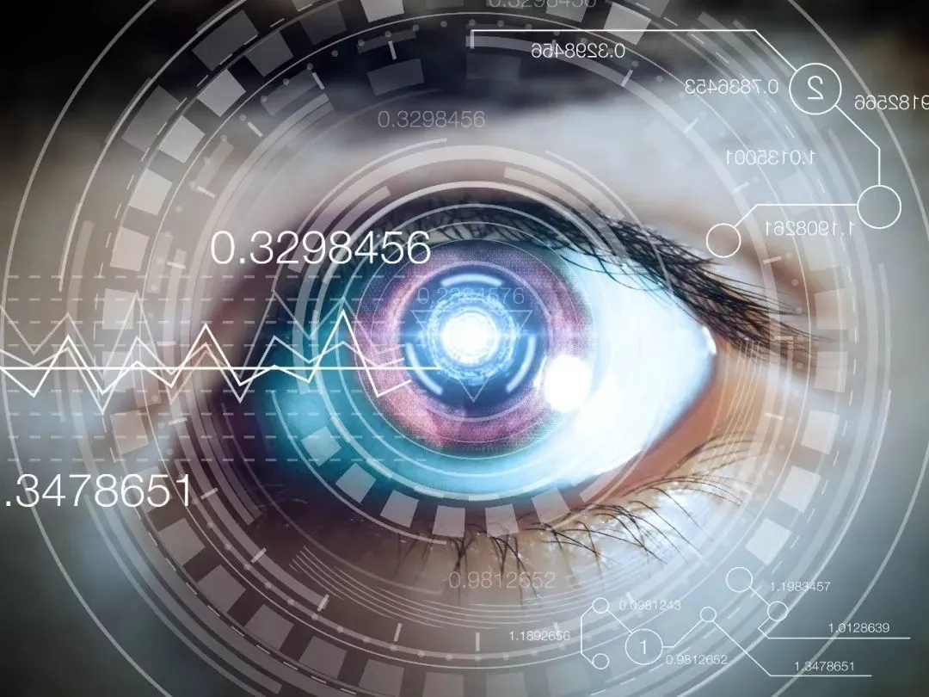
01
Tracklist Design
Reflection
What my album will be about
My information visualization project will be a comprehensive review of my learning journey in information visualization.
Provide a detailed account of my experience.
Delve into the various topics I've invested my efforts in.
Share the difficulties I encountered during my learning journey and how I overcame them.
Offer some advice to other information visualization scholars.
Notes:
My information visualization project will be a comprehensive review of my learning journey in information visualization. Firstly, I will provide a detailed account of my experience, including how I started, the process of selecting courses and resources, and the main insights and growth during the learning process. Secondly, I will delve into the various topics I've invested my efforts in, such as learning data visualization tools and techniques, selecting chart types, and enhancing data analysis and presentation skills. Next, I will share the difficulties I encountered during my learning journey and how I overcame them. This may include challenges in understanding complex tools and techniques, project practice hurdles, and the process of seeking assistance. Finally, I will offer some advice to other information visualization scholars, sharing my experiences and lessons learned during the learning process, as well as what I believe are key elements to success in the field of information visualization. Through this project, I hope to demonstrate the learning path and methods in information visualization to other learners and inspire them to progress in this field.

Slide 17
ZSH
Part 04
Future Hits
Summary of my work and outlook for the future.
Notes:
This is the forth part. Future Hits.

Slide 18




01
Tracklist Design
Reflection
Summary of my work and outlook for the future.
Notes:
Looks like my work in information visualization isn't just about dazzling data displays but also honing my skills in tackling tricky D3.js and Python code puzzles. As for the future? Well, laugh all you want, but sometimes I wonder, "Why does my chart look like it's been scratched by a cat?" So, I plan to keep delving into the deep, mysterious world of visualization. Maybe I'll learn to create some crazier dynamic charts or explore the fusion of virtual reality with data. I mean, who wouldn't want to see their data interpreted as a fiery dance in VR glasses, right? Hmm, and perhaps I'll have to up my game to make my charts as cool as those visualization gurus online.

Slide 19
ZSH
THANK
YOU
Visualization Journey
Statistics
Presented by: ZHAO Shanhe
Information Visualization Semester-End Wrapped
Notes:
Thank you for listening.

